Slide 1

from AE to VAE on MNIST - Let’s trace shape of nodes

Slide 2
Reference
Youtube
Code

Slide 3
Warm Up

Slide 4
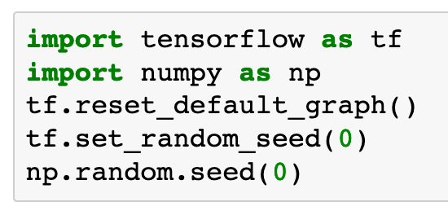

Slide 5
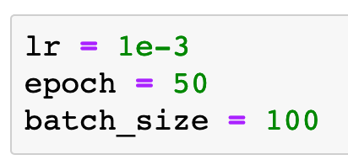

Slide 6
Data

Slide 7


Slide 8
Graph

Slide 9


Slide 10





Slide 11


Slide 12


AE
VAE

Slide 13
AE
VAE

Slide 14



AE
VAE
VAE

Slide 15

AE
VAE
VAE

Slide 16


AE
VAE

Slide 17
AE
VAE

Slide 18

AE
VAE

Slide 19



Slide 20


AE
VAE

Slide 22
Session

Slide 23
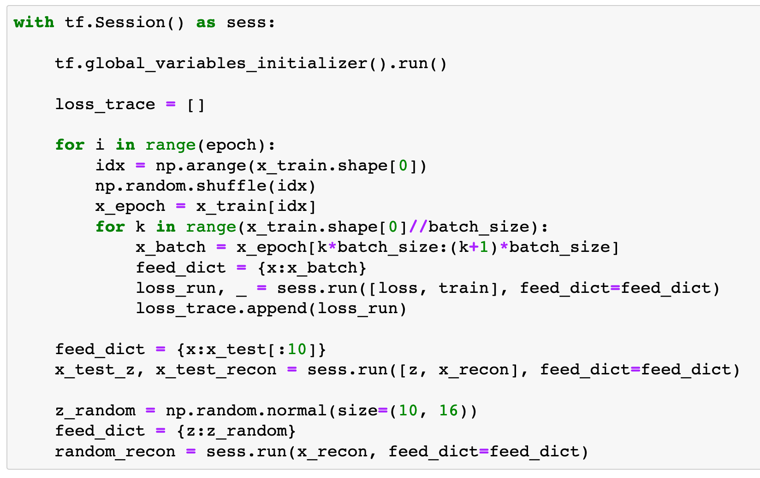

Slide 24
Report Result

Slide 25
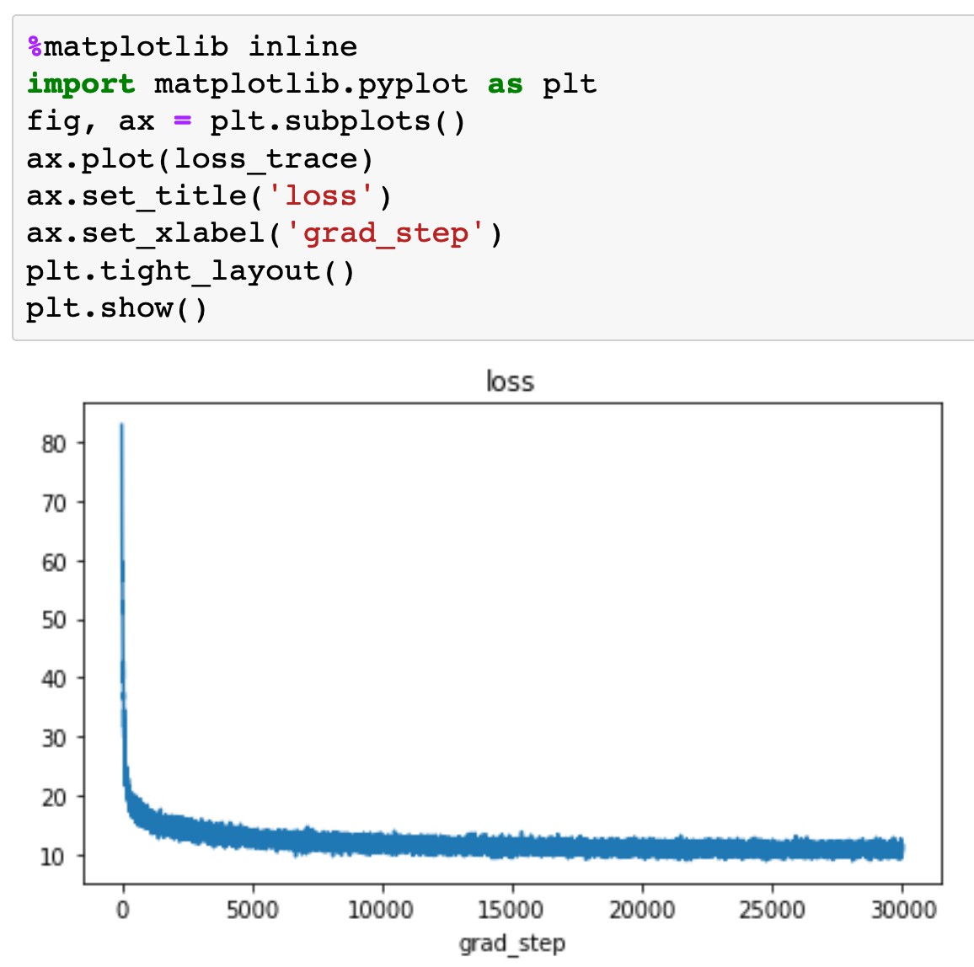
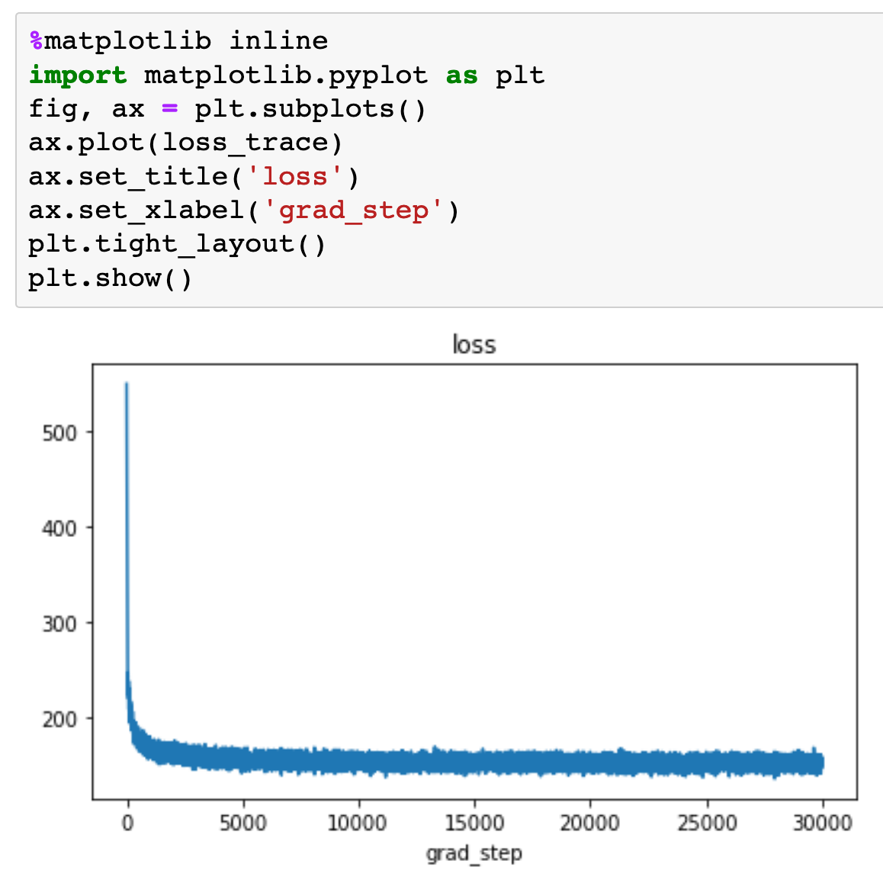
AE
VAE

Slide 26
AE
VAE

Slide 27
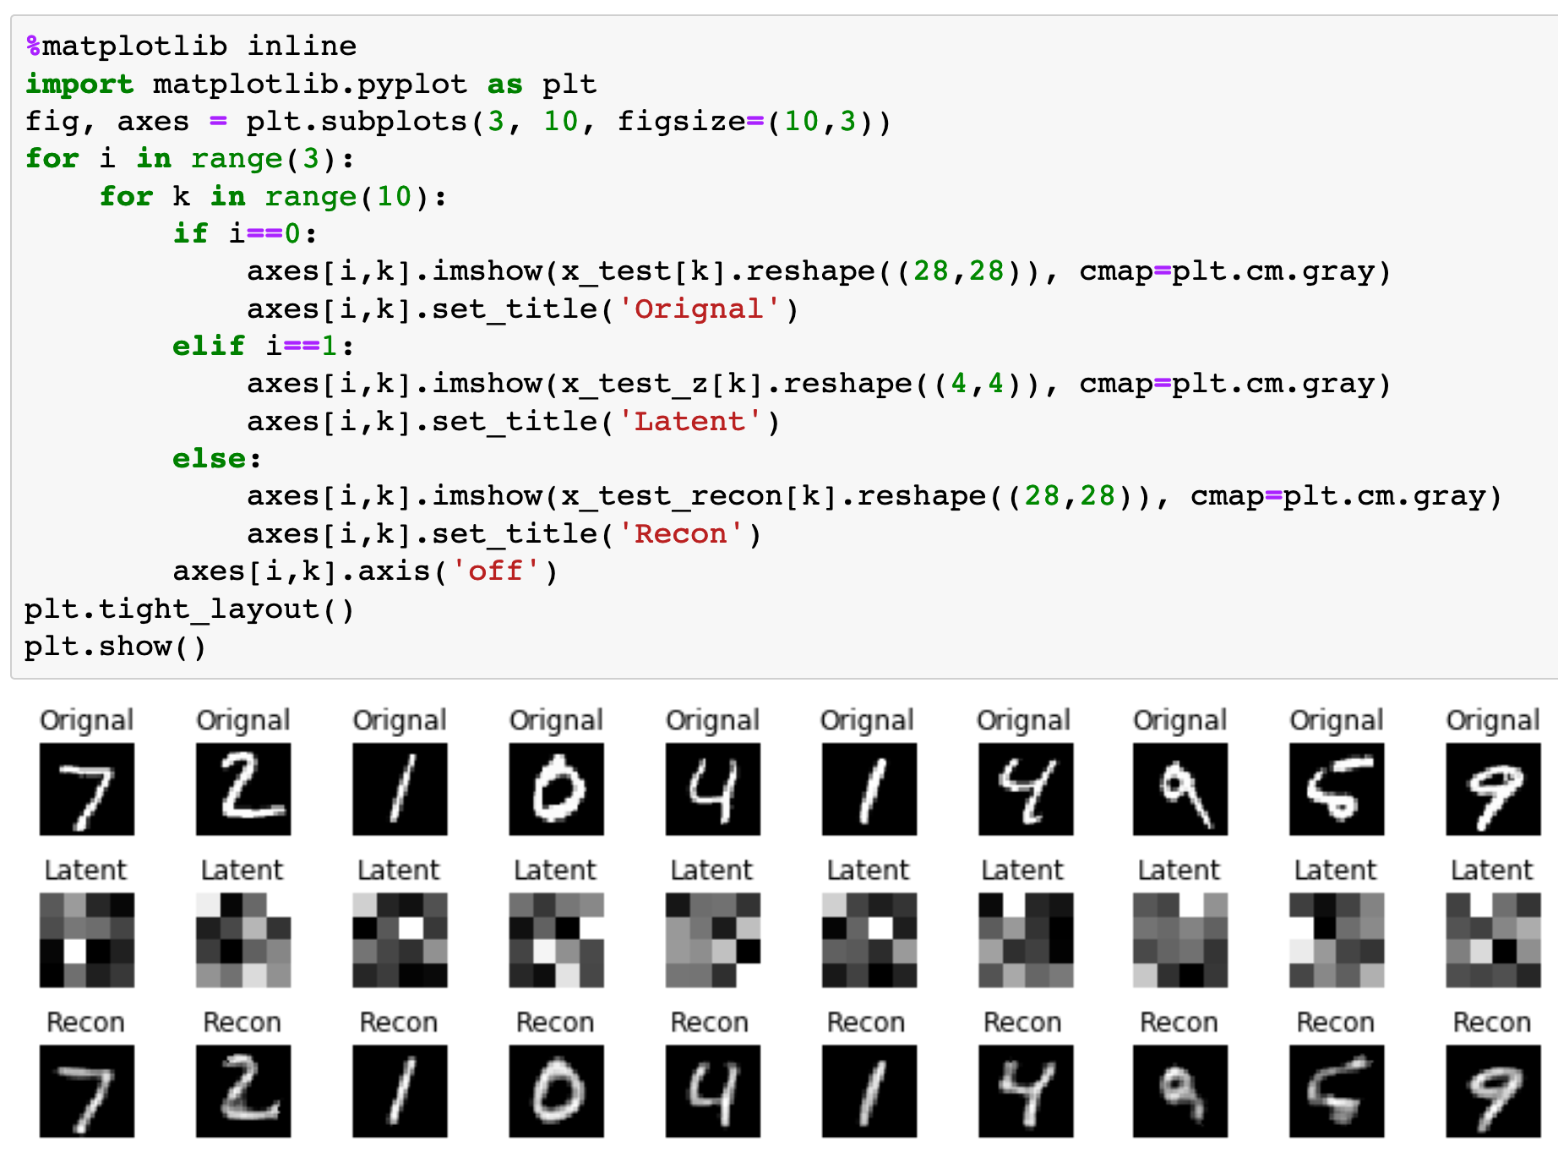
AE

Slide 28
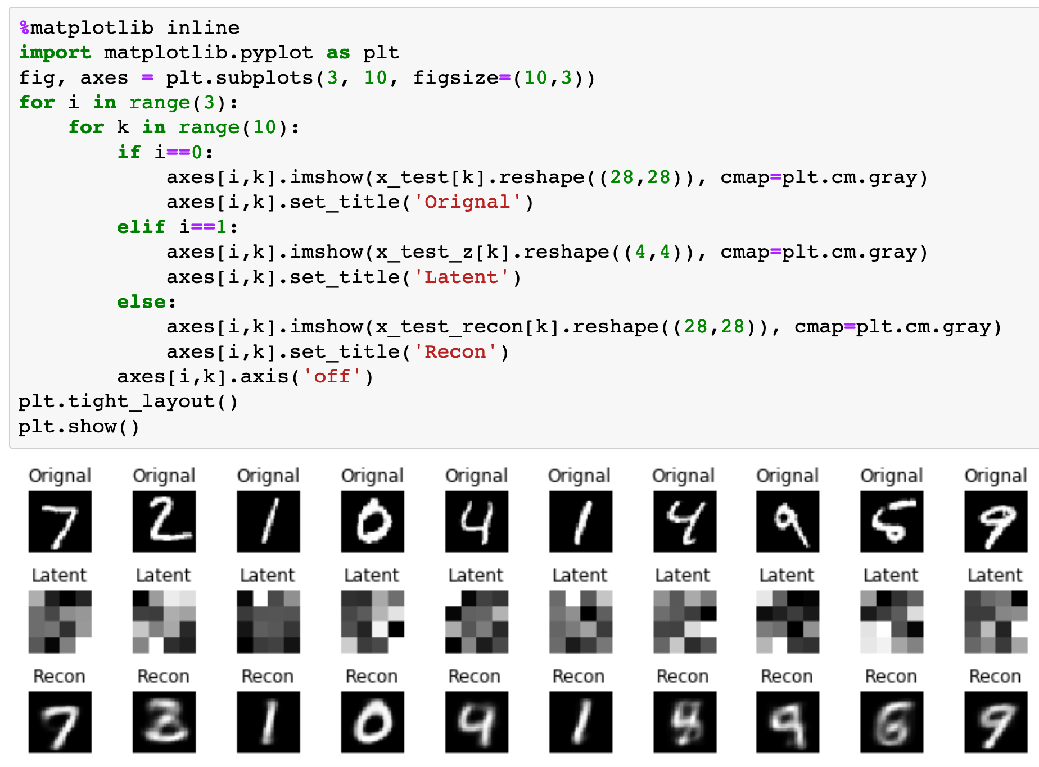
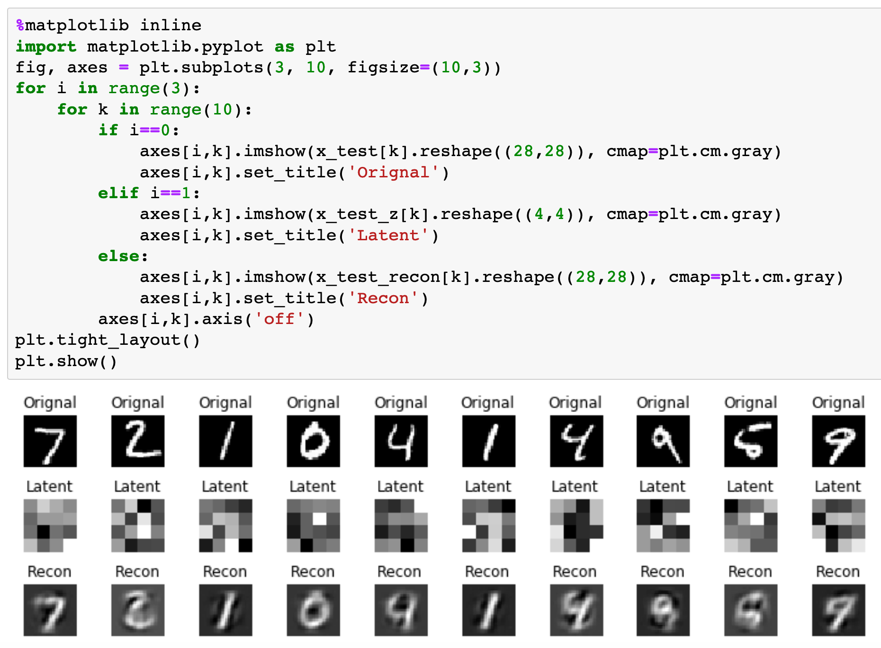
VAE

Slide 29
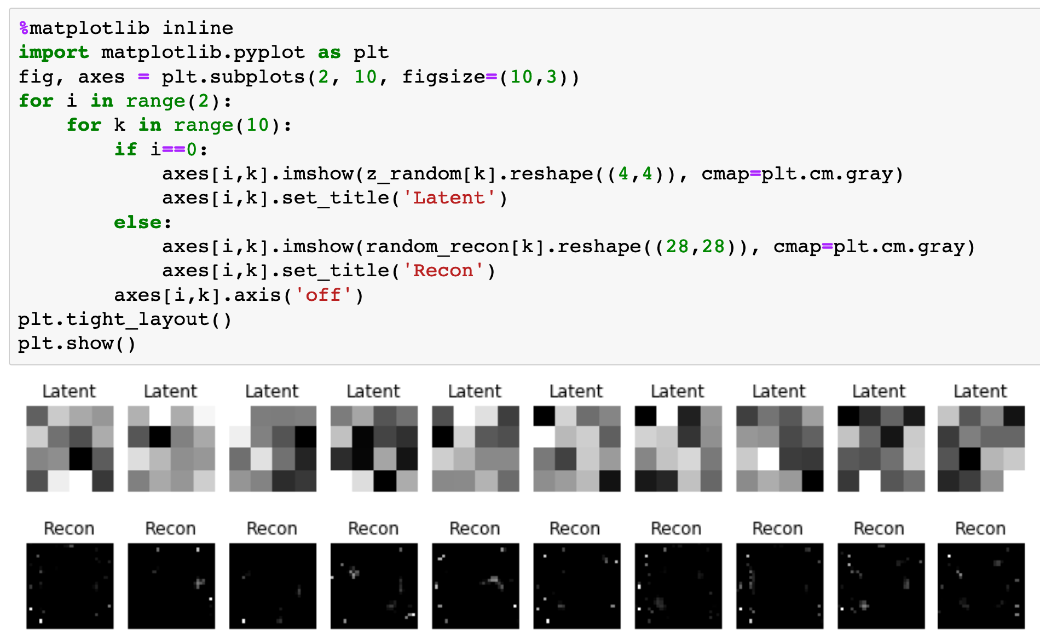
AE

Slide 30
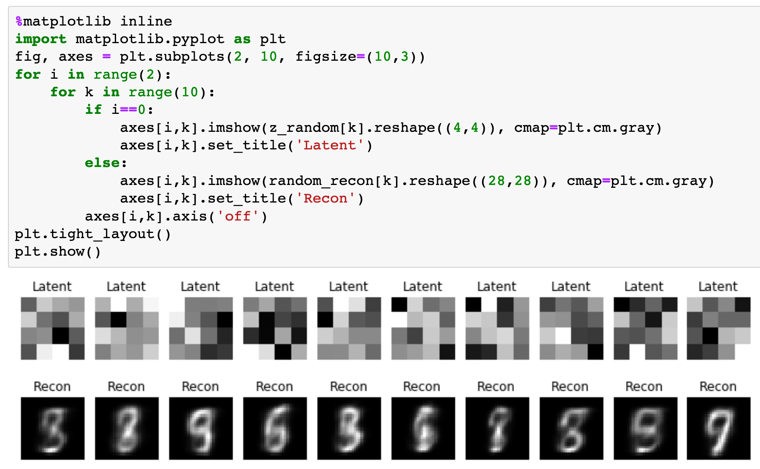
VAE

Slide 31
Now
Let’s Play with Code

